Slide 1

Biological Psychology
Thirteenth Edition
Chapter 8
Wakefulness and Sleep
-Note: highlighted text is background information-
© 2019 Cengage. All rights reserved.

Slide 2
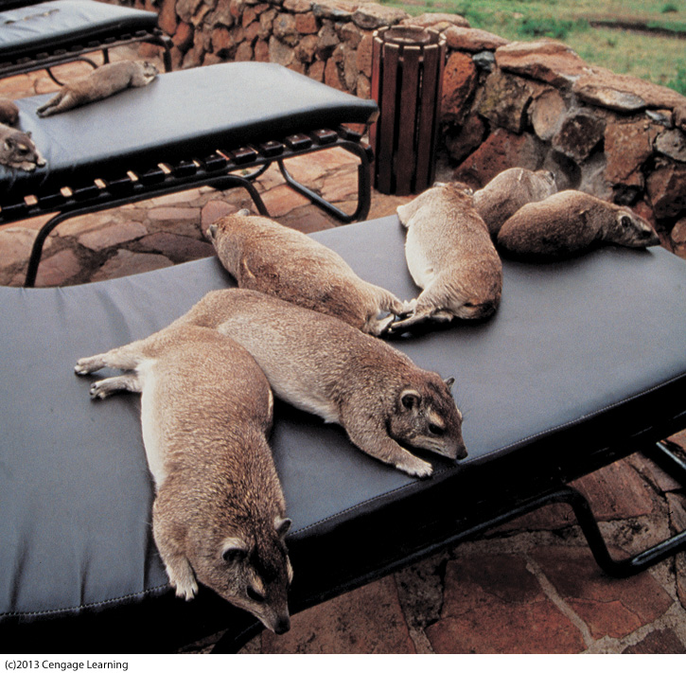
8.1 Rhythms of Waking and Sleeping
Early psychologists believed:
Cycles of wakefulness & sleep were dependent upon external stimuli

Slide 3
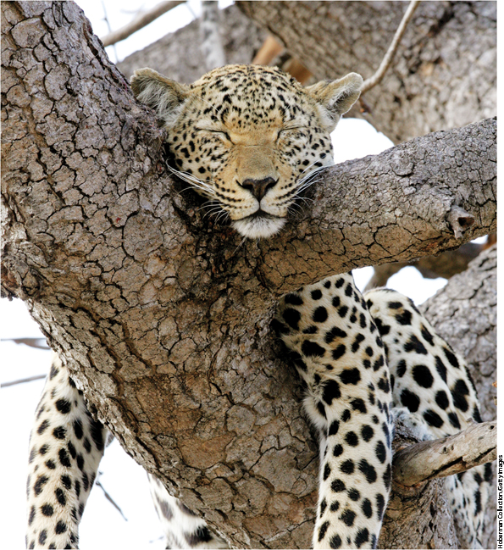
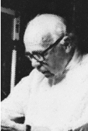
Rhythms of Waking and Sleeping (cont’d.)
1922-
Curt Richter proposed:
Body generates its own cycles of activity & inactivity
Notes:
Sleep is an important part of life for nearly all animals.

Slide 4
Endogenous Circannual Rhythms
Some animals…
…generate endogenous circannual rhythms- internal mechanisms operating on an annual (yearly) cycle
Examples:
Birds’ migratory patterns
Animals storing food for winter

Slide 5
Endogenous Circadian Rhythms
All animals…
…produce endogenous circadian rhythms- internal mechanisms operating on ~24 hour cycle
24 hour cycles of wakefulness & sleep

Slide 6
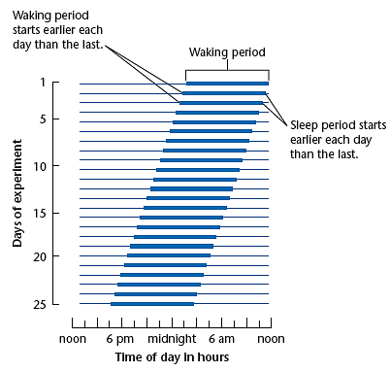
Activity Record of a Flying Squirrel Kept in Constant Darkness (Figure 8.1)
The thickened segments indicate periods of activity as measured by a running wheel. Note that this free-running activity cycle lasts slightly less than 24 hours.
Notes:
Figure 8.1 Activity record of a flying squirrel kept in constant darkness
The thickened segments indicate periods of activity as measured by a running wheel. Note that this free-running activity cycle lasts slightly less than 24 hours.
Adapted from “Phase Control of Activity in a Rodent,” by P. J. DeCoursey, Cold Spring Harbor Symposia on Quantitative Biology, 1960, 25, pp. 49–55

Slide 7
Endogenous Circadian Rhythms (cont’d.)
Circadian rhythms also regulate:
Frequency of eating and drinking
Body temperature
Secretion of hormones
Urination
Sensitivity to drugs

Slide 8
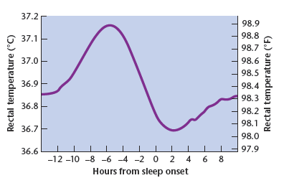
Daily Pattern of Body Temperature
Figure 8.2 Mean rectal temperatures for nine adults
Body temperature reaches its low for the day about 2 hours after sleep onset; it reaches its peak about 6 hours before sleep onset.
Notes:
Figure 8.2 Mean rectal temperatures for nine adults
Body temperature reaches its low for the day about 2 hours after sleep onset; it reaches its peak about 6 hours before sleep onset.
Adapted from “Sleep-Onset Insomniacs Have Delayed Temperature Rhythms,” by M. Morris, L. Lack, and D. Dawson, Sleep, 1990, 13, pp. 1–14

Slide 9
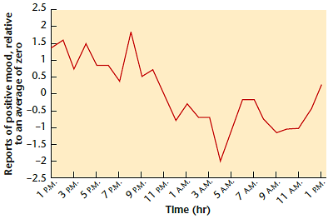
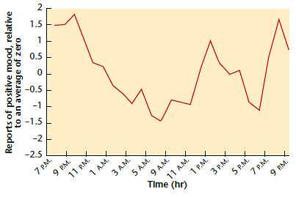
Daily Pattern of Positive Moods
Figure 8.3 Reported positive mood over time
During 30 hours in an unchanging laboratory environment, the average young adult reported most pleasant mood in the late afternoon or early evening, and the least pleasant mood around 5 a.m. to 7 a.m. The pattern was similar for those who started the procedure in the morning (above) or in the evening (below).
Notes:
Figure 8.3 Reported positive mood over time
During 30 hours in an unchanging laboratory environment, the average young adult reported most pleasant mood in the late afternoon or early evening, and the least pleasant mood around 5 a.m. to 7 a.m. The pattern was similar for those who started the procedure in the morning (above) or in the evening (below).
From “Nature’s clocks and human mood: The circadian system modulates reward motivation,” by G. Murray, C. L. Nicholas, J. Kleiman, R. Dwyer, M. J. Carrington, N. B. Allen, et al., 2009, Emotion, 9, pp. 705–716

Slide 10
Setting and Resetting the Biological Clock
Purpose of circadian rhythm is to keep our internal workings in phase with outside world
With no external cue, human circadian clock rhythm is slightly longer than 24 hours
Resetting circadian rhythms is sometimes necessary

Slide 11
Setting and Resetting the Biological Clock (cont’d.)
Zeitgeber: “time giver” (German)
refers to stimulus that resets circadian rhythm
Examples: sunlight, exercise, meals, arousal of any kind, temperature of environment, tides (marine animals), etc.
Effects of using something other than sunlight as a zeitgeber: depression, irritability, impaired job performance

Slide 12
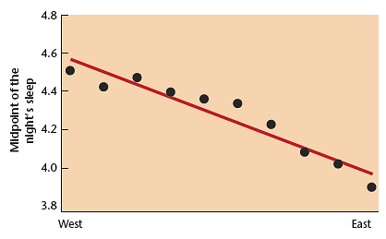
Difference in Sun Time Between East and West Germany
Figure 8.4 Sun time competes with social time
On days when people have no obligation to awaken at a particular time, they awaken about half an hour earlier at the eastern edge of Germany than at the western edge. Points along the y axis represent the midpoint between the preferred bedtime and the preferred waking time. Data are for people living in towns and cities with populations less than 300,000.
Notes:
Figure 8.4 Sun time competes with social time
On days when people have no obligation to awaken at a particular time, they awaken about half an hour earlier at the eastern edge of Germany than at the western edge. Points along the y axis represent the midpoint between the preferred bedtime and the preferred waking time. Data are for people living in towns and cities with populations less than 300,000.
Adapted from Roenneberg, T., et al. [2007] “The human circadian clock entrains to sun time.” Current Biology 17, pp. R44–R45

Slide 13
Jet Lag
Jet lag= disruption circadian rhythms due to crossing time zones
Stems from mismatch between internal circadian clock and external time
Sleepiness during the day
Sleeplessness at night
Impaired concentration

Slide 14
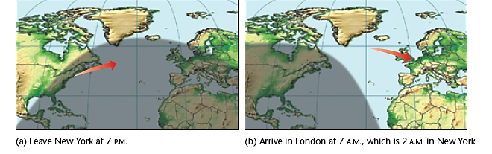
Jet Lag – More Difficult Flying East (Figure 8.5)
Traveling west “phase-delays” circadian rhythms
Traveling east “phase-advances” circadian rhythms
Eastern time is later than western time. People who travel six time zones east fall asleep on the plane and then must awaken when it is morning at their destination but night back home.
Notes:
Figure 8.5 Jet lag
Eastern time is later than western time. People who travel six time zones east fall asleep on the plane and then must awaken when it is morning at their destination but night back home. © Cengage Learning 2013

Slide 15
Morning People and Evening People
Cycles differ between people
→lead to different patterns of wakefulness and alertness
Changes as a function of age
Young children → often morning people
Adolescents → often night people
Adults → partially depends on genetics

Slide 16
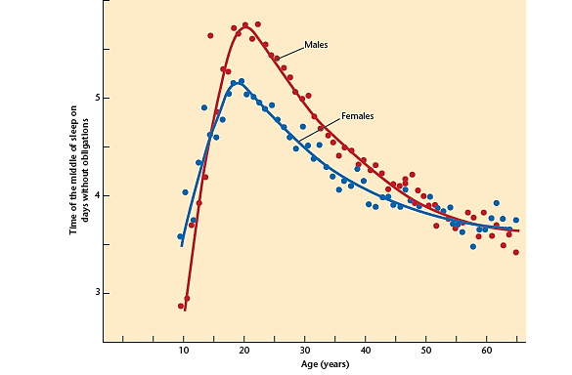
Age and Gender Differences in Circadian Rhythms (Figure 8.6)
People reported the time of the middle of their sleep, such as 3 a.m. or 5 a.m., on days when they had no obligations.
Notes:
Figure 8.6 Age differences in circadian rhythms
People reported the time of the middle of their sleep, such as 3 a.m. or 5 a.m., on days when they had no obligations.
Adapted from T. Roenneberg et al., “A Marker for the End of Adolescence,” Current Biology, 14, pp. R1038–R1039

Slide 17
Shift Work
Sleep duration depends on when one goes to sleep
Night work…
does not reliably change circadian rhythm
tends to have more accidents (vs. day-shift)
people adjust best if:
sleep in a very dark room (during day)
work under very bright lights (at night)

Slide 18
Mechanisms of the Biological Clock
Circadian rhythm mechanisms:
Suprachiasmatic nucleus (SCN)
Genes that produce certain proteins
Melatonin levels

Slide 19
The Suprachiasmatic Nucleus (SCN)
Suprachiasmatic nucleus (SCN)-
part of the hypothalamus
main control center of circadian rhythms for sleep and temperature
Located above the optic chiasm
Damage →less consistent body rhythms
→ no longer synchronized to environmental patterns (light/dark)

Slide 20
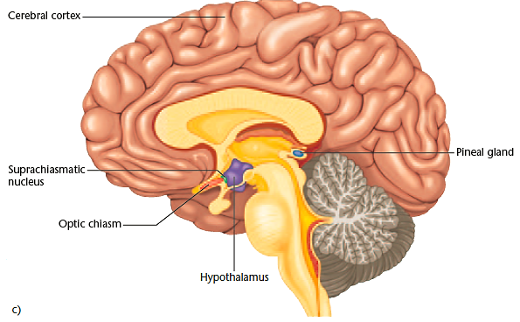
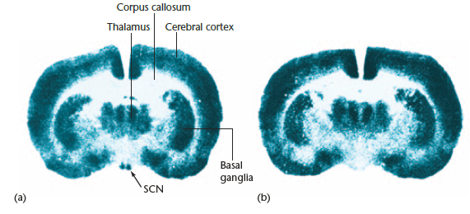
The Suprachiasmatic Nucleus (SCN) of Rats and Humans (Figure 8.7)
The SCN is at the base of the brain, as seen in these coronal sections through the plane of the anterior hypothalamus. Each rat was injected with radioactive 2-deoxyglucose, which is absorbed by the most active neurons. A high level of absorption of this chemical produces a dark appearance on the slide. Note the greater activity in SCN neurons of a rat injected during the day (a), than in one injected at night (b).
(c) A sagittal section through a human brain showing the location of the SCN and the pineal gland.
Notes:
Figure 8.7 The suprachiasmatic nucleus (SCN) of rats and humans
The SCN is at the base of the brain, as seen in these coronal sections through the plane of the anterior hypothalamus. Each rat was injected with radioactive
2-deoxyglucose, which is absorbed by the most active neurons. A high level of absorption of this chemical produces a dark appearance on the slide. Note the greater
activity in SCN neurons of a rat injected during the day (a), than in one injected at night (b). (c) A sagittal section through a human brain showing the location of the SCN and the pineal gland.
Adapted from “Suprachiasmatic nucleus: Use of 14C-labeled deoxyglucose uptake as a functional marker,” by W. J. Schwartz & H. Gainer, Science 1977, 197: pp. 1089–1091, AAAS/American Association for the Advancement of Science

Slide 21
The Suprachiasmatic Nucleus (SCN) and the Circadian Rhythm
SCN generates circadian rhythms in a genetically controlled, unlearned manner
Single cell extracted from SCN and raised in tissue culture continues to produce action potentials in a rhythmic pattern
Various cells communicate to sharpen circadian rhythm

Slide 22
The Suprachiasmatic Nucleus (SCN) and the Retinohypothalamic Path
Light resets SCN via small branch of optic nerve known as the retinohypothalamic path
Travels directly from retina to SCN
Retinohypothalamic path comes from special population of ganglion cells that have their own photopigment called melanopsin
Cells respond directly to light and do not require any input from rods or cones

Slide 23
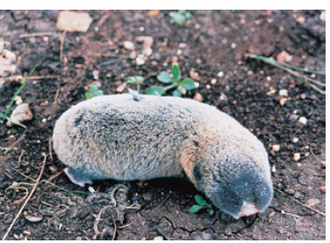
Resetting the SCN Without Sight
Figure 8.8 A blind mole rat
Although blind mole rats are blind in other regards, they reset their circadian rhythms in response to light.
Notes:
Figure 8.8 A blind mole rat
Although blind mole rats are blind in other regards, they reset their circadian rhythms in response to light. Courtesy of Eviatar Nevo

Slide 24
The Biochemistry of the Circadian Rhythm
Two types of genes are responsible for generating the circadian rhythm
Period: produce proteins called PER
Timeless: produce proteins called TIM

Slide 25
The Biochemistry of the Circadian Rhythm (cont’d.)
PER & TIM proteins increase activity of certain SCN neurons that regulate sleep and waking
Known mutations in the PER gene result in:
short circadian rhythms (look forward to going to bed early, often have depression)
decreased alertness if deprived of a good night’s sleep

Slide 26
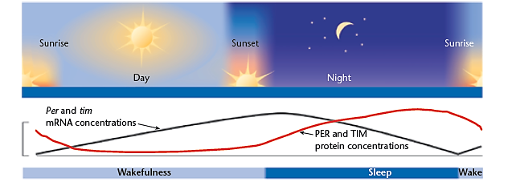
Interaction of MRNA with PER and TIM Proteins
Figure 8.9 Feedback between proteins and genes to control sleepiness
In fruit flies (Drosophila), the concentrations of the mRNA levels for PER and TIM oscillate over a day, and so do the proteins that they produce.
Notes:
Figure 8.9 Feedback between proteins and genes to control sleepiness
In fruit flies (Drosophila), the concentrations of the mRNA levels for PER and TIM oscillate over a day, and so do the proteins that they produce. © Cengage Learning

Slide 27
Melatonin
SCN regulates waking and sleeping by controlling activity levels in other areas…
→regulates pineal gland
(endocrine gland posterior to thalamus)
→ secretes melatonin- hormone that increases sleepiness

Slide 28
Melatonin (cont’d.)
Melatonin
secretion begins ~2-3 hrs before bedtime
feeds back to reset biological clock through effects on receptors in SCN
Melatonin taken in afternoon can phase-advance internal clock
can be used as a sleep aid

Slide 29
8.2 Stages of Sleep and Brain Mechanisms
Sleep is a specialized state evolved to serve particular functions
What are the mechanisms for producing sleep?

Slide 30
Sleep
Sleep: a state that the brain actively produces
Characterized by moderate decrease in brain activity & decreased response to stimuli
Sleep differs from the following states:
Coma
Vegetative state
Minimally conscious state
Brain death

Slide 31
Other Interruptions of Consciousness
Coma: extended period of unconsciousness characterized by low brain activity that remains fairly steady
Little or no response to stimuli (incl. pain)
Caused by head trauma, stroke or disease
Person typically dies or begins recovery within a few weeks

Slide 32
Other Interruptions of Consciousness (cont’d.)
Vegetative state: person alternates between periods of sleep and moderate arousal but no awareness of surrounding
Some autonomic arousal (h heart rate/ breathing/ sweating) to painful stimulus
No purposeful activity/ response to speech
Can last for months or years

Slide 33
Other Interruptions of Consciousness (cont’d.)
Minimally conscious state: one stage higher than vegetative state
Occasional brief periods of purposeful action
Limited speech comprehension
Can last for months or years

Slide 34
Other Interruptions of Consciousness (cont’d.)
Brain death:
No sign of brain activity
No response to any stimulus
Physicians usually wait 24hrs before pronouncing brain death

Slide 35
Stages of Sleep – EEG
Electroencephalograph (EEG) allowed researchers to discover various stages of sleep
Researchers can compare brain activity at different times during sleep
Polysomnograph= combination of EEG and eye-movement records

Slide 36
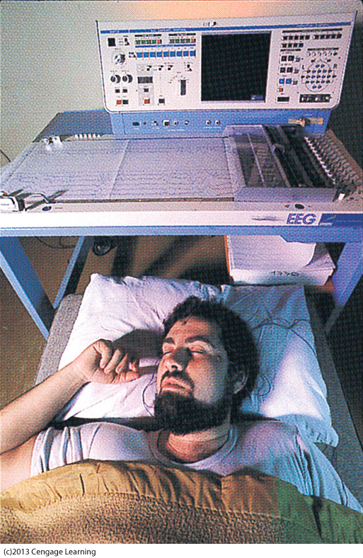
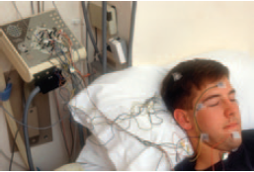
Brain Activity Recorded on an EEG During Sleep
12th/13th edition, above- Figure 8.10 Sleeping person with electrodes in place on the scalp for recording brain activity
11th edition, left- The printout above his head shows the readings from each electrode.
Notes:
Figure 8.10 Sleeping person with electrodes in place on the scalp for recording brain activity Hank Morgan/Rainbow/RGB Ventures LLC dba SuperStock/Alamy

Slide 37
Relaxation and Stage 1 Sleep
Alpha waves (8-12 Hz)= present during states of relaxation
Stage 1 sleep= when sleep has just begun
EEG dominated by irregular, jagged, and low voltage waves
Brain activity begins to decline

Slide 38
Stage 2 Sleep
Stage 2 sleep characterized by presence of:
Sleep spindles: 12-14 Hz waves during a burst that lasts at least half a second
K-complex: a sharp wave associated with temporary inhibition of neuronal firing

Slide 39
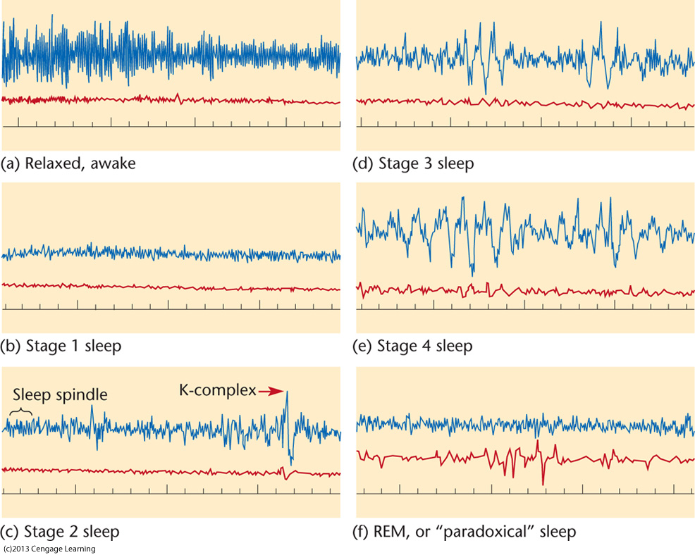
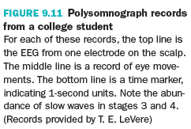
Stage 1 & 2 Sleep

Slide 40
Slow Wave Sleep
Stage 3 & stage 4 together constitute slow wave sleep (SWS), characterized by:
Slow, large amplitude EEG waves
Slowing of heart rate, breathing rate, and brain activity
Highly synchronized neuronal activity
Note: 13th edition no longer separates SWS into Stages 3 and 4

Slide 41
Paradoxical or REM Sleep
Rapid eye movement sleep (REM)= sleep periods characterized by rapid eye movements
AKA paradoxical sleep: deep sleep in some ways, but light sleep in other ways
EEG waves irregular, low-voltage, and fast
Postural muscles of the body more relaxed than other stages

Slide 42
Slow Wave Sleep (prior stages 3/4) & REM Sleep

Slide 43
NREM and REM Cycles
Stages other than REM= non-REM sleep (NREM)
Sleep progresses through stages 1, 2, & SWS in sequential order
After ~1 hr, sleeper begins to cycle back through the stages from SWS to 2 & then REM
Sequence repeats w/ each cycle lasting ~90 mn

Slide 44
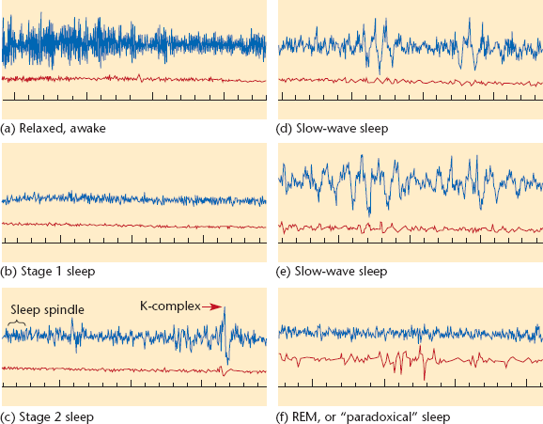
Polysomnograph Records from a College Student (Figure 8.11- revised version from 13th ed.)
For each of these records, the top line is the EEG from one electrode on the scalp. The middle line is a record of eye movements. The bottom line is a time marker, indicating 1-second units. Note the abundance of slow waves in slow-wave sleep.
Notes:
Figure 8.11 Polysomnograph records from a college student
For each of these records, the top line is the EEG from one electrode on the scalp. The middle line is a record of eye movements. The bottom line is a time marker, indicating 1-second units. Note the abundance of slow waves in stages 3 and 4.
Source: Records provided by T. E. LeVere

Slide 45
NREM and REM Cycles
Slow wave sleep (stage 3/4) predominates early in night
Length of stage decreases as night progresses

Slide 46
NREM and REM Cycles (cont’d.)
REM sleep is predominant later in night
Length increases as night progresses
REM is strongly associated with dreaming…
…BUT people also report dreaming in other stages of sleep

Slide 47
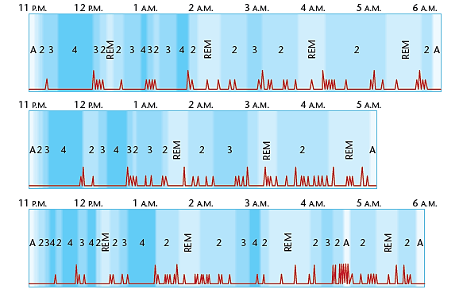
Typical Sequences of Sleep Stages
Figure 8.12 Sleep stages on three nights
Columns indicate awake (A) and sleep stages 2, 3, 4, and REM. Deflections in the line at the bottom of each chart indicate shifts in body position. Note that slow-wave sleep occurs mostly in the early part of the night’s sleep, whereas REM sleep becomes more prevalent toward the end.
Notes:
Figure 8.12 Sleep stages on three nights
Columns indicate awake (A) and sleep stages 2, 3, 4, and REM. Deflections in the line at the bottom of each chart indicate shifts in body position. Note that
slow-wave sleep occurs mostly in the early part of the night’s sleep, whereas REM sleep becomes more prevalent toward the end. Source: Based on Dement & Kleitman, 1957a

Slide 48
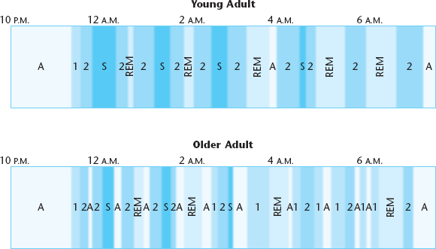
Typical Sleep Stages for a Young Adult and an Older Adult (Figure 8.13, new to 13th edition)
Columns indicate awake, stage 1, stage 2, slow-wave sleep, and REM. Note that the older adult has less slow-wave sleep and more frequent awakenings. Based on data from Scullin & Bliwise (2015).
Notes:
Figure 8.12 Sleep stages on three nights
Columns indicate awake (A) and sleep stages 2, 3, 4, and REM. Deflections in the line at the bottom of each chart indicate shifts in body position. Note that
slow-wave sleep occurs mostly in the early part of the night’s sleep, whereas REM sleep becomes more prevalent toward the end. Source: Based on Dement & Kleitman, 1957a

Slide 49
Brain Mechanisms of Wakefulness and Arousal – Reticular Formation
Various brain mechanisms are associated with wakefulness and arousal
Reticular formation= part of midbrain that extends from the medulla to forebrain
→ responsible for arousal

Slide 50
Brain Mechanisms of Wakefulness and Arousal – Pontomesencephalon
Pontomesencephalon= part of midbrain that contributes to cortical arousal
Axons extend to hypothalamus, thalamus, and basal forebrain, which release acetylcholine, glutamate, or dopamine
Produce excitatory effects to widespread areas of cortex
Stimulation of pontomesencephalon awakens sleeping individuals and increases alertness in those already awake

Slide 51
Brain Mechanisms of Wakefulness and Arousal – Locus Coeruleus
Locus coeruleus= small structure in pons
→ axons release norepinephrine to arouse various areas of cortex and increase wakefulness
Usually dormant while asleep

Slide 52
Brain Mechanisms of Wakefulness and Arousal – Hypothalamus
Hypothalamus contains neurons that release “histamine” to produce widespread excitatory effects throughout the brain
Antihistamines produce sleepiness

Slide 53
Brain Mechanisms of Wakefulness and Arousal – Orexin
Orexin= peptide neurotransmitter
→ highly responsible for ability to stay awake (rather than to wake up)
→ also called hypocretin
→ released from hypothalamus
(lateral & posterior nuclei)

Slide 54
Brain Mechanisms of Wakefulness and Arousal – Orexin (cont’d.)
Orexin:
Stimulates acetylcholine-releasing cells in the basal forebrain to stimulate neurons responsible for wakefulness and arousal
Basal forebrain is an area just anterior and dorsal to the hypothalamus

Slide 55
Brain Mechanisms of Wakefulness and Arousal – GABA and Acetylcholine
Cells of basal forebrain release the inhibitory neurotransmitter GABA
Inhibition by GABA is essential for sleep
Other axons from basal forebrain release acetylcholine- excitatory, increases arousal

Slide 56
Sleep and the Inhibition of Brain Activity
Functions of the inhibitory neurotransmitter GABA are also important for:
Decreasing temperature & metabolic rate
Decreasing stimulation of neurons

Slide 57
Brain Structures for Arousal and Sleep
Structure | Neurotransmitter(s) It Releases | Effects on Behavior
Pontomesencephalon | Acetylcholine, glutamate | Increases cortical arousal
Locus Coeruleus | Norepinephrine | Increases information storage during wakefulness; suppresses REM sleep
Basal Forebrain (Excitatory Cells) | Acetylcholine | Excites thalamus and cortex; increases learning, attention; shifts sleep from NREM to REM
Basal Forebrain (Inhibitory Cells) | GABA | Inhibits thalamus and cortex
Hypothalamus (parts) | Histamine | Increases arousal
Hypothalamus (parts) | Orexin | Maintains wakefulness
Dorsal Raphe and Pons | Serotonin | Interrupts REM sleep
Notes:
© Cengage Learning

Slide 58
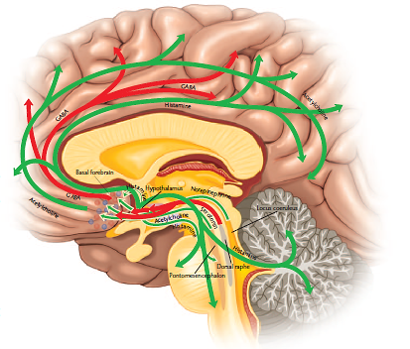
Brain Mechanisms of Sleeping and Waking (Figure 8.14)
Green arrows indicate excitatory connections. Red arrows indicate inhibitory connections. Neurotransmitters are indicated where they are known.
Notes:
Figure 8.14 (13th ed.; 8.13 in 12th ed.) Brain mechanisms of sleeping and waking
Green arrows indicate excitatory connections. Red arrows indicate inhibitory connections. Neurotransmitters are indicated where they are known. Source: Based on J.-S. Lin, Hou, Sakai, & Jouvet, 1996; Robbins & Everitt, 1995; Szymusiak, 1995

Slide 59
Sleep as a Local Phenomenon
Sleep can be local within the brain
Sleepwalkers: awake in one part of brain and asleep in others
Lucid dreaming: dreaming but aware of being asleep and dreaming
Inability to move: pons remaining in REM while other brain areas wake up

Slide 60
Brain Function in REM Sleep During REM sleep:
Activity increases:
Pons
(triggers onset of REM)
Limbic system
(emotional system)
Parietal cortex
Temporal cortex
Activity decreases:
Primary visual cortex
Motor cortex
Dorsolateral prefrontal cortex

Slide 61
Brain Function in REM Sleep (cont’d.)
REM sleep also associated with distinctive pattern of high-amplitude electrical potentials known as PGO waves
Waves of neural activity are detected…
→ first in Pons,
→ then lateral Geniculate (thalamus),
→ and finally Occipital cortex

Slide 62
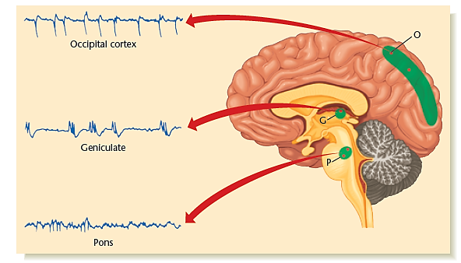
PGO Waves and REM Sleep (Figure 8.16) PGO waves start in the pons (P) and then show up in the lateral geniculate (G) and the occipital cortex (O). Each PGO wave is synchronized with an eye movement in REM sleep.
REM deprivation results in high density of
PGO waves during uninterrupted sleep
Notes:
Figure 8.16 (13th ed.; 8.15 in 12th ed.) PGO waves
PGO waves start in the pons (P) and then show up in the lateral geniculate (G) and the occipital cortex (O). Each PGO wave is synchronized with an eye movement in REM sleep. © Cengage Learning

Slide 63
Brain Function in REM Sleep (cont’d.)
Cells in pons send messages to spinal cord
→ inhibits motor neurons that control large muscles of body
→ prevents motor movement during REM sleep

Slide 64
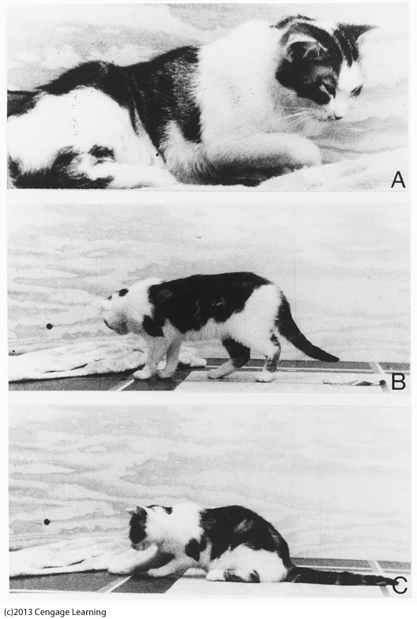
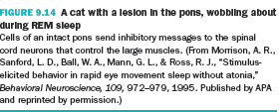
Brain Function in REM Sleep (cont’d.)
Notes:
Figure 8.15 in 13th edition

Slide 65
Brain Function in REM Sleep (cont’d.)
REM is also regulated by serotonin and acetylcholine
Drugs that stimulate acetylcholine receptors quickly move people to REM
Serotonin interrupts REM

Slide 66
Sleep Disorders- Insomnia
Insomnia= sleep disorder associated with inadequate sleep
Caused by various factors:
noise, stress, pain, diet, medication
dependence on sleeping pills or alcohol
shifts in circadian rhythms
Can be result of disorders:
epilepsy, Parkinson’s disease, depression, anxiety or other conditions

Slide 67
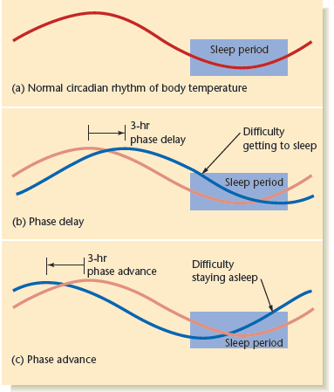
Sleep Disorders as a Result of Phase Delay
Figure 8.17 Insomnia and circadian rhythms
People with a phase delay have trouble getting to sleep. People with a phase advance have trouble staying asleep.
Notes:
Figure 8.17 (13th ed.; 8.16 in 12th ed.) Insomnia and circadian rhythms
People with a phase delay have trouble getting to sleep. People with a phase advance have trouble staying asleep. © Cengage Learning

Slide 68
Sleep Apnea
Sleep apnea= sleep disorder characterized by inability to breathe while sleeping for a prolonged period of time
Consequences:
sleepiness during the day
impaired attention
depression
sometimes heart problems

Slide 69
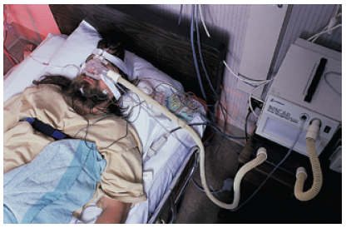
Medical Options to Improve Sleep Apnea
Figure 8.18 A continuous positive airway pressure (CPAP) mask
The mask fits snugly over the nose and delivers air at a fixed pressure, strong enough to keep the breathing passages open.
Notes:
Figure 8.18 (13th ed.; 8.17 in 12th ed.) A continuous positive airway pressure (CPAP) mask
The mask fits snugly over the nose and delivers air at a fixed pressure, strong enough to keep the breathing passages open. Russell Curtis/Science Source

Slide 70
Sleep Apnea (cont’d.)
Causes:
obesity
genetics
hormones
old age
deterioration of brain mechanisms controlling breathing
Cognitive impairment may result

Slide 71
Narcolepsy
Narcolepsy is a sleep disorder characterized by frequent periods of sleepiness
[Cover of book “The Mysterious Benedict Society]

Slide 72
Narcolepsy (cont’d.)
Four main symptoms (not always present)
1) Gradual or sudden attack of sleepiness
2) Occasional cataplexy: muscle weakness triggered by strong emotions
3) Sleep paralysis: inability to move while falling asleep or waking up
4) Hypnagogic hallucinations: dreamlike experiences

Slide 73
Narcolepsy (cont’d.)
Narcolepsy seems to run in families although no gene has been identified
Cause: lack of hypothalamic cells that produce and release orexin
Primary treatment: stimulant drugs (i.e., Ritalin)
→increase wakefulness by enhancing dopamine & norepinephrine activity

Slide 74
Narcolepsy with Cataplexy
http://www.youtube.com/watch?v=3MBCeKn0Oeo

Slide 75
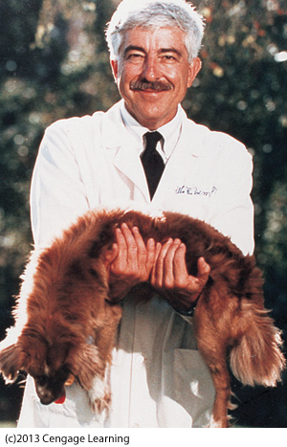
Dogs that lack the gene for orexin receptors have symptoms much like human narcolepsy

Slide 76
Curr Opin Pulm Med. 2013 Nov;19(6):587-93. doi: 10.1097/MCP.0b013e328365af97.
Narcolepsy and H1N1 vaccination: a link?
Thebault S, Vincent A, Gringras P.
a Neuroimmunology Group, Nuffield Department of Clinical Neurosciences, Oxford University, Oxford
b Paediatric Sleep Medicine Department, Evelina London and Kings College London, London, UK.
PURPOSE OF REVIEW:
A number of European countries have reported a dramatic increase in the rates of childhood narcolepsy with cataplexy in children immunized with a split-virion adjuvanted swine flu vaccine. Here, we review the strengths and weaknesses of these epidemiological studies and possible neuroimmunological mechanisms.
RECENT FINDINGS:
Initial concerns of a 13-fold increased relative risk of narcolepsy were raised by the Scandinavian health protection agencies in 2010. Subsequent retrospective studies support these findings in Canada, France, Ireland, England and Denmark. The cases are predominantly young children who present with severe and rapid onset of cataplexy as well as narcolepsy often within a few weeks of vaccination. The proposed mechanism for postvaccination narcolepsy is one in which an environmental trigger causes or enhances an antibody-mediated autoimmune response in patients with a preexisting genetic susceptibility. However, there have not yet been any reports of specific autoimmunity, either antibody or T-cell-mediated.
SUMMARY:
There is a strong association between narcolepsy and H1N1 vaccination. However, whether this reflects a true increase in affected individuals or a hastening of disease onset in individuals who would otherwise have developed narcolepsy later will become clear in the coming years. The pathological explanation of this association and narcolepsy is likely to be autoimmune, although supportive evidence is lacking.
Video abstract available:
See the Video Supplementary Digital Content 1 (http://links.lww.com/COPM/A9).
PMID: 24048081 [PubMed - in process]

Slide 77
Periodic Limb Movement Disorder
Periodic limb movement disorder= repeated involuntary movement of legs and sometimes arms while sleeping
Legs kick once every 20-30 seconds for periods of minutes to hours
Usually occurs during NREM sleep
Tranquilizers can help in some cases

Slide 78
REM Behavior Disorder
REM behavior disorder= associated with vigorous movement during REM sleep
Usually associated with acting out dreams
Research suggests:
Inadequate GABA & other inhibitory neurotransmitters may be responsible

Slide 79
Night Terrors
Night terrors= experiences of intense anxiety from which a person awakens screaming in terror
Usually occurs in NREM sleep
More common in children
Dream content- if any- is usually simple (such as a single image)

Slide 80
Sleepwalking (Somnambulism)
“Sleepwalking” runs in families, mostly occurs in young children, and occurs mostly in slow wave sleep
Not usually associated with dreaming
More common when sleep-deprived or under unusual stress
It is not dangerous to wake a sleepwalker

Slide 81
Sleepwalking/talking http://www.youtube.com/watch?v=aNYT_rOgvIA Mom’s reaction http://www.youtube.com/watch?NR=1&feature=fvwp&v=ibQ3-EwdthM

Slide 82
Sexsomnia
An analogous condition is “sleep sex” or sexsomnia: engaging in sexual behavior (with a partner or by masturbation) while asleep
Person doesn’t remember afterwards
Can pose a threat to romances/marriages!

Slide 83
8.3 Why Sleep? Why REM? Why Dreams?
We’ve evolved mechanisms to force us to sleep
Inhibitory processes in our brains force us to become less aroused and less alert, and thus to sleep

Slide 84
Functions of Sleep
Some functions of sleep include:
Resting muscles
Decreasing metabolism
Performing cellular maintenance in neurons
Reorganizing synapses
Strengthening memories

Slide 85
Sleep and Energy Conservation
Original function of sleep was probably to conserve energy
Conservation of energy is accomplished via:
Decrease in body temperature of ~1-2 degrees Celsius (mammals)
Decrease in muscle activity

Slide 86
Hibernation is Analogous to Sleep
Decrease in body temperature-
→only slightly above the environment
Heart rate & brain activity drop-
→almost nothing
Neuron cell bodies shrink, dendrites lose almost ¼ of branches
→Replaced later when body temperature increases

Slide 87
Some Facts About Hibernation
Bear “hibernation”- not as extreme as smaller hibernators (bats, ground squirrels)
Hibernating animals come out of hibernation a few hours every few days
Hibernation…
retards the aging process
is a period of relative invulnerability to infection and trauma

Slide 88
Species Differences in Sleep
Animals’ sleep habits are influenced by particular aspects of their life, including:
Whether they are predator or prey
How many hrs spent daily looking for food
Safety from predators while sleeping

Slide 89
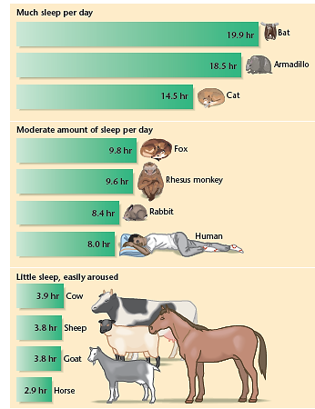
Figure 8.19 Hours of sleep per day for various species
Generally, predators and others that are safe when they sleep tend to sleep a great deal. Animals in danger of being attacked while they sleep spend less time asleep.
Notes:
Figure 8.19 (13th ed.; 8.18 in 12th ed.) Hours of sleep per day for various species
Generally, predators and others that are safe when they sleep tend to sleep a great deal. Animals in danger of being attacked while they sleep spend less time asleep. © Cengage Learning

Slide 90
Species Differences in Sleep (cont’d.)
Animal sleep difference examples:
Dolphins/whales-
Half of brain sleeps at a time
Stay awake 24hrs/day for a few weeks after birth
Migratory birds-
Decreased need for sleep
If caged, restless & sleeps only 1/3 usual amount

Slide 91
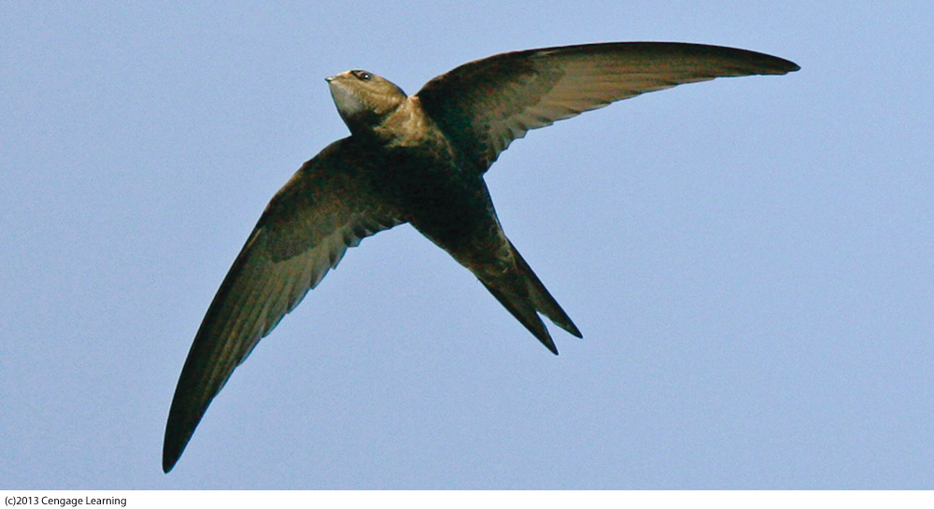
Species Differences in Sleep (cont’d.)
Another
example:
Swifts-
Baby takes off from nest and doesn’t land again for up to 2 years!
Presumably sleeps while gliding at night

Slide 92
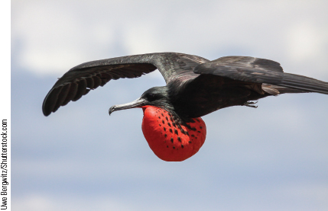
Species Differences in Sleep (cont’d.)
Great Frigate bird-
Also spends most nights in the air
EEG studies: periods of SWS- just one hemisphere; REM in both equally; sleep episodes brief (11 sec.; total <45 mn./night)- compared to 12 hrs. on land

Slide 93
Sleep and Memory
Sleep also plays important role enhancing learning & strengthening memory
Performance on newly learned task often better next day if adequate sleep during the night
While asleep, increased brain activity occurs in area of brain activated by a newly learned task

Slide 94
Sleep and Memory (cont’d.)
Patterns of hippocampus activity during learning were similar to those during sleep
Suggests that brain replays daily experiences during sleep
Brain strengthens some synapses and weakens others during sleep
Sleep spindles increase in number after new learning: correlated with nonverbal IQ

Slide 95
Amounts of REM Sleep
Species vary in amount of REM sleep time
Most common in birds and mammals
Percentage of REM sleep positively correlated with total amount of sleep in most animals
Cats spend up to 16 hours a day sleeping with lots of that time in REM sleep

Slide 96

Amounts of REM Sleep (cont’d.)
The lion sleeps tonight … and maybe part of the morning … and much of the afternoon, too.

Slide 97
Amounts of REM Sleep (cont’d.)
Humans spend 1/3 of lifetime asleep
1/5 of sleep time spent in REM
Those who get the most sleep have the highest percentage of REM

Slide 98
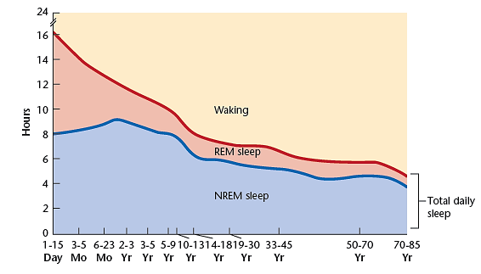
The Relationship Between Age and REM Sleep for Humans
Figure 8.20 Sleep patterns for people of various ages
REM sleep occupies about 8 hours a day in newborns but less than 2 hours in most adults. The sleep of infants is not quite like that of adults, however, and the criteria for identifying REM sleep are not the same.
Notes:
Figure 8.20 (13th ed., 8.19 in 12th ed.) Sleep patterns for people of various ages
REM sleep occupies about 8 hours a day in newborns but less than 2 hours in most adults. The sleep of infants is not quite like that of adults, however, and the criteria for identifying REM sleep are not the same. Source: From “Ontogenetic Development of Human Sleep- Dream Cycle,” by H. P. Roffwarg, J. N. Muzio, and W. C. Dement, 1966, Science, 152, pp. 604–609. Copyright 1966 AAAS. Reprinted by permission.

Slide 99
Functions of REM Sleep
Research inconclusive regarding exact functions of REM
During REM:
Brain may discard useless connections
Learned motor skills may be consolidated
Maurice (1998) suggests the function of REM is simply to shake eyeballs back and forth to provide sufficient oxygen to corneas

Slide 100
Biological Perspectives on Dreaming
Biological research on dreaming complicated because subjects cannot often accurately remember what was dreamt
Two biological theories of dreaming:
Activation-synthesis hypothesis
Neurocognitive hypothesis
(→”Clinico-anatomical hypothesis” in 12th edition and earlier)

Slide 101
The Activation-Synthesis Hypothesis
Activation-synthesis hypothesis suggests dreams begin with spontaneous activity in pons, which activates many parts of cortex
Cortex synthesizes a story from pattern of activation (brain’s effort to make sense of it)
Sensory stimuli (sounds in room, etc) sometimes get incorporated, but usually not
Examples- 1) dream of ‘falling’ because posture is lying down- different from waking posture; 2) when dreaming, you really can’t move→ common dream

Slide 102
The Neurocognitive Hypothesis
Neurocognitive hypothesis places less emphasis on pons, PGO waves, or even REM sleep
Derived from brain-damaged patients
Suggests dreams are similar to thinking taking place under unusual circumstances- like mind wandering when awake

Slide 103
The Neurocognitive Hypothesis (cont’d.)
Dreams begin with arousing stimuli generated within the brain (similar to Activ-synth)
+ recent memories
+ information coming in from senses
[Pearls Before Swine comic:
http://www.gocomics.com/pearlsbeforeswine/2013/10/19]

Slide 104
The Neurocognitive Hypothesis (cont’d.)
Since brain is getting little information from sense organs, images are generated without constraints or interference
Arousal can not lead to action as primary motor cortex and motor neurons of spinal cord are suppressed
Activity in prefrontal cortex is suppressed, which impairs working memory during dreaming

Slide 105
The Neurocognitive Hypothesis – Conditions
Activity is high in inferior part of parietal cortex- area important for visual-spatial perception
Patients with damage:
problems binding body sensations with vision
have no dreams
Activity also high in areas outside of V1, accounting for the visual imagery of dreams

Slide 106
The Neurocognitive Hypothesis – Summary
Activity high in hypothalamus and amygdala
→ accounts for emotional and motivational content of dreams
Internal or external stimulation activates parts of parietal, occipital & temporal cortex
No visual input (from V1) + no criticism from prefrontal cortex→ hallucinatory perceptions

Slide 107
Activation-synthesis VS Neurocognitive
Interpret sparse info
PGO waves (visual)
+ other brain activity
already occurring
→ synthesizes story
e.g. “falling” b/c posture
Unusual ‘thinking’
Brain arousal (similar)
+ recent memories
+ info from senses
→ hallucinatory
e.g. “falling” b/c pushed!

